Slide 1
LESSONS FROM JONAH
Matthew 12:38-42

Slide 2
OUTLINE OF JONAH
Chapter 1: Running from God
Chapter 2: Running back to God
Chapter 3: Running with God
Chapter 4: Running ahead of God

Slide 3
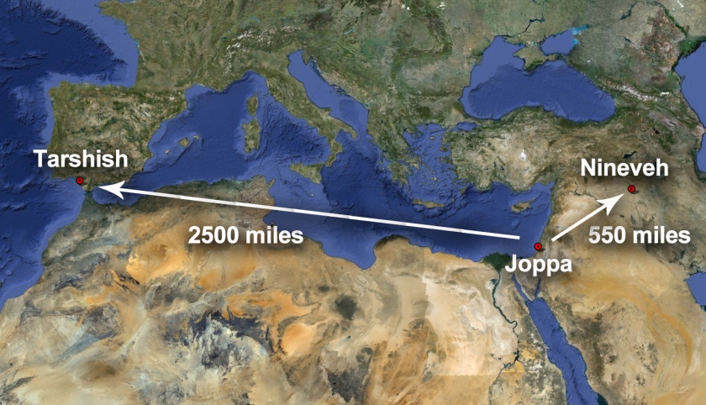
JONAH’S DESTINATIONS

Slide 4
JONAH Chapter 1
Running from God
  God commands Jonah to go to Nineveh and cry against it
  Jonah attempts to flee to Tarshish by going to Joppa and paying passage on a ship
  The Lord hurls a great wind and storm
  Every man cried to his god for salvation, however, no record that Jonah cried to his God
  Jonah admits that he is responsible for the storm and asks to be thrown overboard
  Jonah thrown into the sea, the storm stops
  Men feared the Lord, offered sacrifice, made vows
  God appoints a great fish to swallow Jonah
  Jonah lives inside the fish three days and three nights

Slide 5
JONAH Chapter 2
Running back to God
  Jonah prays to God from inside the fish
  Jonah credits God for hearing his distress while in the sea
  Jonah credits God for answering his call of distress
  Jonah credits God’s ownership of the breakers and the billows
  Jonah describes his desperation as he was encompassed by water, weeds wrapped around his head – to the point of death
  Jonah credits God with his salvation, sparing his life from drowning by sending a great fish
  Jonah points out the folly of those who regard vain idols
  Jonah offers thanksgiving, promising sacrifice and fulfillment of vows, noting “Salvation is from the Lord.”
  God commands the fish to vomit Jonah onto dry land

Slide 6
JONAH Chapter 3
Running with God
  God commands Jonah again to go to Nineveh and cry against it, proclaiming what He would tell him
  Jonah obeyed God, arose, and went to Nineveh
  Jonah preached to a third of the city, “Yet 40 days and Nineveh will be overthrown.”
  Jonah convinced the people of Nineveh, they believed in God, fasted and put on sackcloth (signs of repentance)
  Word spread throughout the city, even to the king, who also believed, repented, and proclaimed a city-wide fast to avoid the judgment of God and certain destruction
  God witnessed their deeds, their repentance, and changed His mind regarding their destruction

Slide 7
JONAH Chapter 4
Running ahead of God
  Jonah is displeased with God’s sparing of His wrath against Nineveh, and becomes angry, questioning God’s decision
  Jonah prays to God, telling Him “I told you so,” that if the people of Nineveh were preached to, that they might repent and be spared destruction, because of the compassionate nature of God
  Jonah pleads to die, as he doesn’t want to be held responsible for the salvation of a gentile nation, an enemy of Israel
  Jonah makes a shelter and sits to watch if God might still destroy the city (to follow his advice)
  God appoints a plant for shelter, then a worm to attack the plant, then a scorching east wind
  Jonah is angry once again and pleads to die
  God points out Jonah’s hypocrisy in feeling compassion for a plant and none for over 120,000 ignorant people and their animals

Slide 8
LESSONS FROM JONAH
No one can run or hide from God. He is the Creator of heaven and earth and all that is in them.
We must obey God and teach repentance to the lost.
We must not second-guess God or think that our ideas are better than His.
When God forgives people, we must also forgive them. We must strive to be more like Him.
We must not grumble at the will of God, for His compassion is righteous.

Slide 9
Appointments of God
In the book of Jonah …
God appoints a fish, and it swallows then vomits up Jonah.
God appoints a plant, and it grows up and provides shade for Jonah.
God appoints a worm and it attacks the plant and makes it wither.
God appoints a scorching east wind, and it made Jonah miserable.

Slide 10
Appointments of God
In the book of Hebrews, we learn …
“… It is appointed for men to die once and after this comes judgment, so Christ also, having been offered once to bear the sins of many, will appear a second time for salvation without reference to sin, to those who eagerly await Him.” (Hebrews 9:27)
In the book of Acts, we learn …
“… Therefore having overlooked the times of ignorance, God is now declaring to men that all people everywhere should repent, because He has fixed a day in which He will judge the world in righteousness through a Man whom He has appointed, having furnished proof to all men by raising Him from the dead.” (Acts 17:30-31)

Slide 11
The Invitation of Christ to receive the gift of Eternal Life
Hear (Romans 10:14-17, James 1:21)
Believe (Hebrews 11:6, Ephesians 2:8-10)
Repent (Luke 13:3, Acts 17:30)
Confess (Romans 10:10, Matthew 10:32-33)
Be Baptized (Mark 16:16, Galatians 3:23-27)
Remain Obedient to God (Matthew 7:21)

